Slide 1

Lecture-17
HEAPS
•
Priority Queues
•
Heaps
Kartik Mathur

Slide 2

2
How to find min/max out of
some elements?

Slide 3
3
Implement using unsorted List
1.
Min
RemoveMin
Insert
2.
3.
* Arrays, Linked List and Binary Trees?

Slide 4
4
Selection Sort?

Slide 5
5
Implement using sorted List
1.
Min
RemoveMin
Insert
2.
3.

Slide 6
6
Insertion Sort?

Slide 7
7
Any other options?

Slide 8
8
Heaps

Slide 9
9
Heap Data Structure
1.
Binary Tree
Complete Binary
2.
Tree Property
Heap Order Property
3.

Slide 10
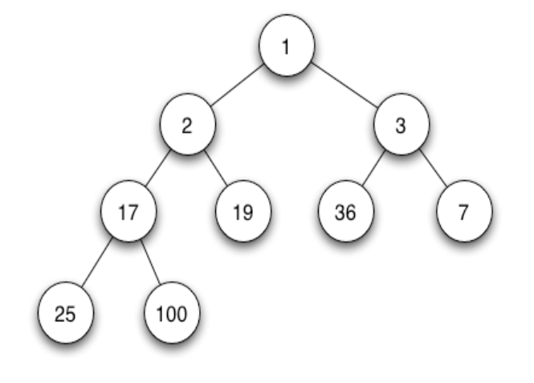
10

Slide 11
11
What is the height of a
complete binary tree?

Slide 12
12
Complete Binary Tree
1.
Add
Remove
2.

Slide 13
13
Priority Queues

Slide 14
14
Priority Queues
Class PriorityQueue{
// accessor methods
int size();
bool isEmpty();
T min();
// update methods
void insert(int priority, T value);
void removeMin();
}

Slide 15
15
How to implement a
complete binary tree

Slide 16
16
How to implement Heap using CBT?
1.
Min
Insertion
removeMin
2.
3.

Slide 17
17
Heap Sort

Slide 18
18
Heap Sort is O(nLogN)

Slide 19
19
Time to find top K elements?

Slide 20
Thank You!
Kartik Mathur

